Slide 1

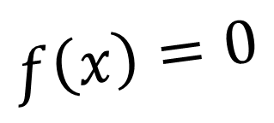
CH2021 Root-Finding Methods
$$f\left(x\right)=0$$
Class 12
September 1, 2022

Slide 2




Structure
$$f\left(x\right)=0$$
Section 1
Computer Programming in Fortran
Section 2
Roots of Equations
Section 3
Linear Algebraic Equations
Section 4
Ordinary Differential Equations
Bracketing methods
Open methods
Roots of polynomials
$$\frac{dy}{dx}=g\left(x,y\right)$$
$$\left[A\right]\left[x\right]=\left[b\right]$$
Gauss Elimination
LU Decomposition
Gauss-Seidel
Runge-Kutta methods
Multistep methods
Boundary value problems
$$\frac{d^{2}y}{dx^{2}}=g\left(x,y\right)$$

Slide 3





Quadratic
$$f\left(x\right)=0$$
$$ax^{2}+bx+c=0$$
$$\frac{−b−\sqrt{b^{2}−4ac}}{2a}$$
$$\frac{−b+\sqrt{b^{2}−4ac}}{2a}$$
Homework

Slide 4

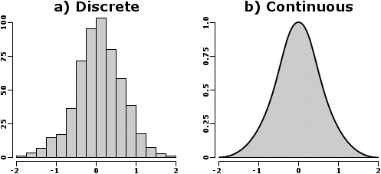
f(x) = 3x + sin(x) - e^{x}

Slide 5

f(x) changes signs between x = 0 and x = 1

